Slide 1
The PID Controller

Slide 2
Note for Next CLass
Talk about noise on sensors
Talk about complimentary filter
Talk about PID rate
Demo
Noise
Noise reduction
Complimentary filter.
Integral windup
Tuning PID
Control registers for IMU
Register maps
Writing registers
Relationship between registers and circuit schematics of IMU internals
Combine this lecture with the fligh control software lecture

Slide 3
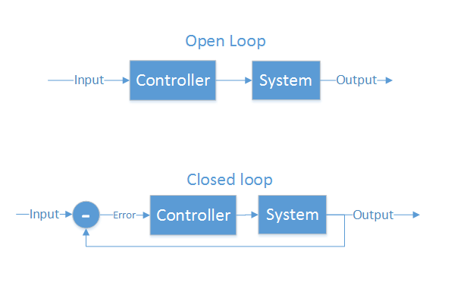
Control Theory
Making a physical system do what you want
“Open loop” and “closed loop”
Open loop - cannot see the system’s output
Motor controllers
LCD/LED/CRT screens
Some ICBMs
Closed loop - Can see output, make corrections
Autopilot
GPS guided munitions
Our quadcopter

Slide 4
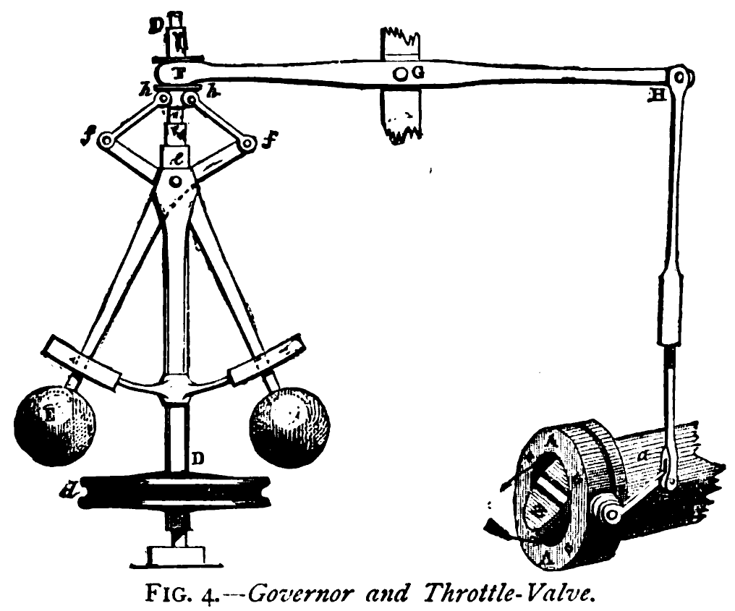
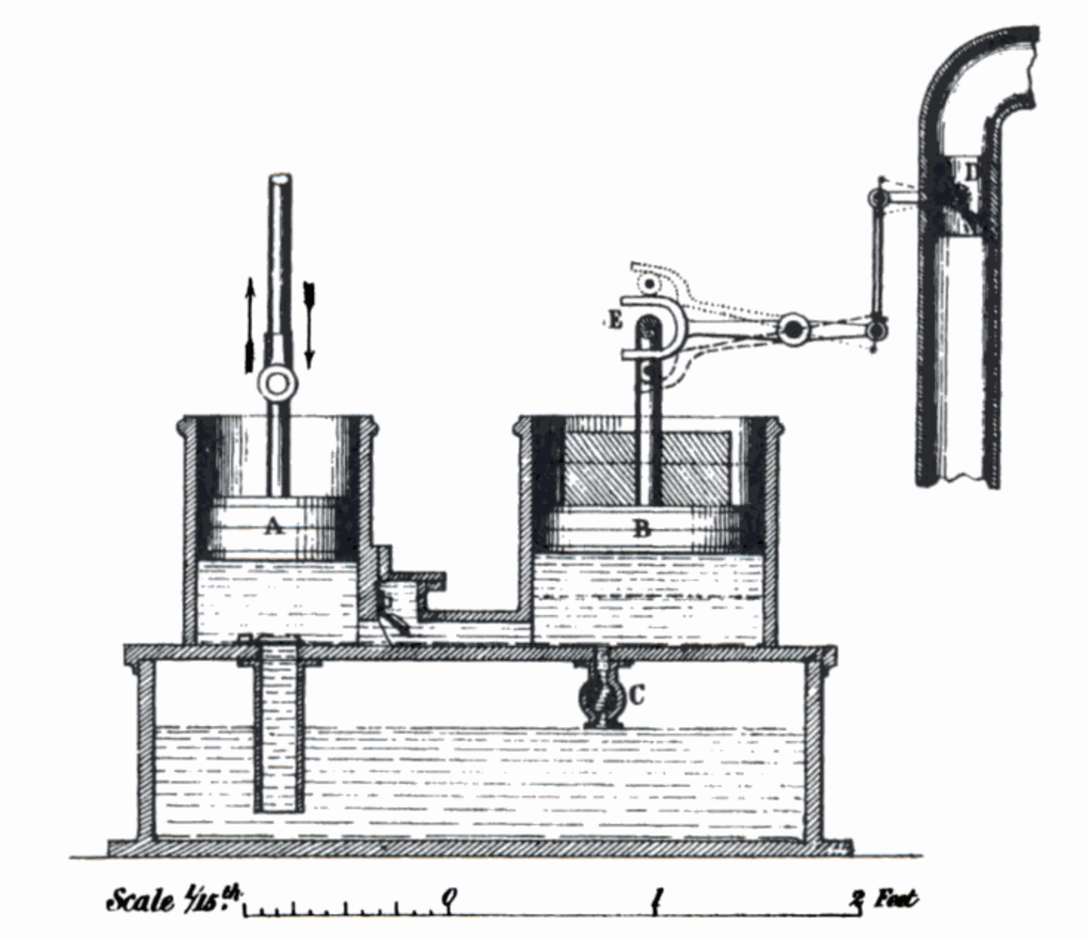
What is PID?
Make a system follow a set point
“Proportional, Integral, Derivative”
A brief history:
1788 - James Watt’s flyball governor (P)
1837 - Louis Molinié hydraulic regulator (PI)
1857 - H.N. Throop marine engine governor (PD)
1868 - Maxwell gives theoretical basis
1911 - Elmer Sperry, ship steering (PID)

Slide 5
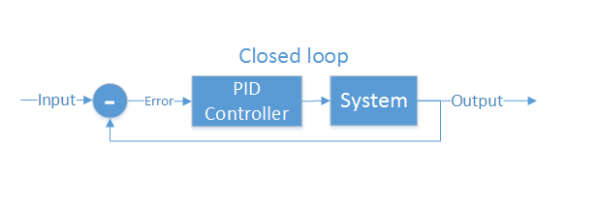
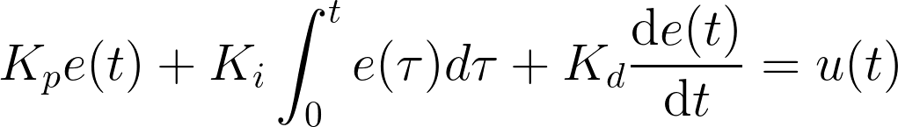
Closed loop control
PID is the most common closed loop controller
Proportional: Directly against error
Integral: Remembers error over time
Derivative: Dampens response to avoid oscillations

Slide 6
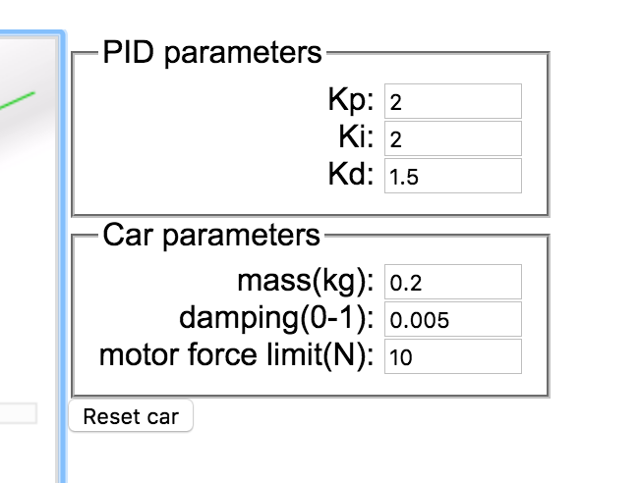
Example
https://sites.google.com/site/fpgaandco/pid

Slide 7
PID on the Quadcopter
3 separate controllers
PID set point is from user

Slide 8
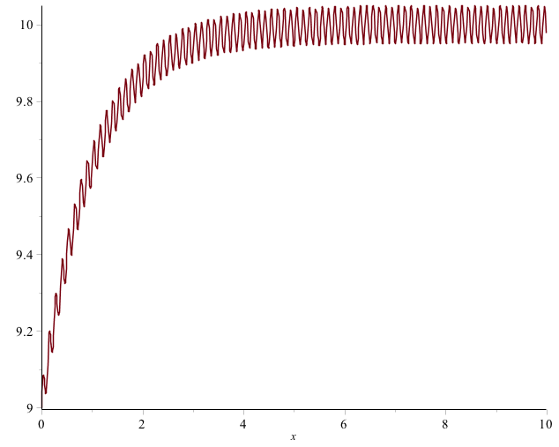
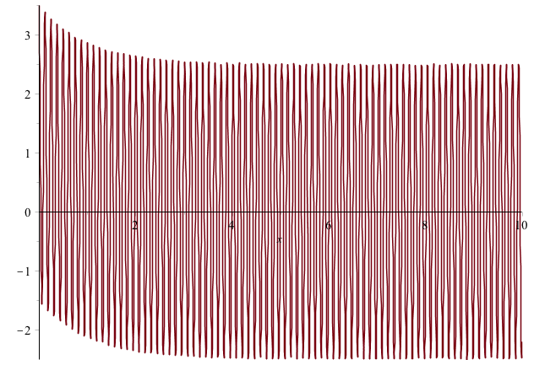

Pitfalls of PID
Integral term “Windup”
One solution: Exponential decay on integral (E.g., I = I/2 + error)
Derivative noise: beware of vibrations
Error term with vibration
Derivative term causes your system to go insane
Solution: moving average of last several values. Or median of last several values.
Using the serial plotter in arduino to watch the D term.
3. Tweaking PID values
Tune P first, then D, then I.

